Slide 1

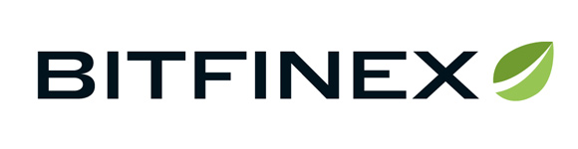








Bitcoin Arbitrage Bot Probes
Yaodong Wang
CSE 775 DO
2018 Spring

Slide 2
contents
Review architecture and activity
Probe 1, Golang concurrency pattern
Probe 2, React chart
Probe 3, Result analysis

Slide 3
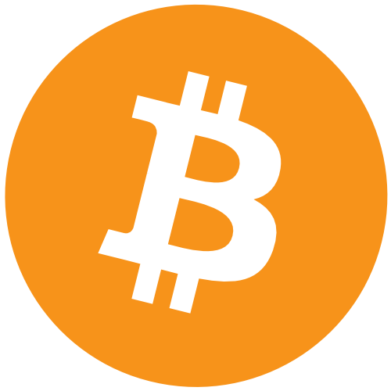
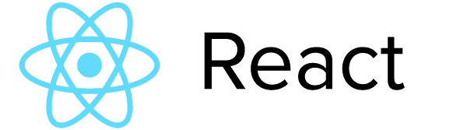


System Architecture
Real-time task
( synch )
Non real-time task
( Asynch )
Browser UI
Restful get
BTC-USD
Go Bot
server
RESTful
goroutines
Express
RESTful post
simulating
persist

Slide 4
Activity
Exchange API
---------
Cryptocurrency
tic
React component
G
ticker
Get tick
Tick Trade simulator
(goroutines)
Refresh data
Transact [ delay ]
(goroutines)
trigger
Exchange API
---------
Cryptocurrency
Event loop (NodeJS)
Profit after delay
N
Get tick
Price ticker
(goroutines)
Y
REST post
(goroutine)
Profit?
N
Collect tick data
(goroutine)
mongodb
Tick data + Ideal profit

Slide 5
Probe 1 – Go Concurrency Pattern
Basic
Goroutine
Channel
Buffered channel -> strong synch to involved goroutines
Unbuffered channel -> not that strong synch to involved goroutines
Timeout/ ticker is also channel
Demo

Slide 6
how many goroutines?
tic
main
1: tick price
G
ticker
Get tick
2: tick price
Trade simulator
Transact [ delay ]
…
trigger
10: tick price
Get tick
Profit after delay
Goroutine
Y
11: post2node
Rest post
Profit?
12: simulator
N
15: …
Collect tick data
Tick data + Ideal profit
14: delayed transact
13: delayed transact

Slide 7
Tick synch
tick synch tasks
non-synch tasks
blocked
tic
tick! @6
tick! @12
G
ticker
Get tick
1: tick price
2: tick price
Trade simulator
Transact [ delay ]
…
…
trigger
10: tick price
Get tick
Profit after delay
Goroutine
Y
11: post2node
Rest post
Profit?
12: tick simulate
N
Collect tick data
13: delayed transactor
Tick data + Ideal profit

Slide 8


Tick synch *
It’s @6!
Fetch tick price,
Then send to channel
tick synch tasks
non-synch tasks
blocked
It’s @6!
Start simulating
tick! @6
tick! @12
1: tick price
2: tick price
[1] price
…
…
It’s @6!
So do I.
Unbuffered channel
11: post2node
[12] simulator
12: tick simulate
[2] price
13: delayed transact

Slide 9
Tick synch* with unbuffered channel
non-synch tasks
Keep asking: Is my data rcvd by simulator? ( blocked )
tick synch tasks
blocked
Fetch data from channel
tick! @6
tick! @12
1: tick price
2: tick price
[1] price
…
…
So do I…
Ah, my data is rcvd.
I lost my job! (lifetime is over)
Unbuffered channel
[12] simulator
11: post2node
12: tick simulate
13: delayed transact
[2] price

Slide 10

Tick synch * with time-consuming trade
It’s @6!
Start simulating
tick synch tasks
non-synch tasks
blocked
tick! @6
tick! @12
[1] price
1: tick price
2: tick price
[2] price
Unbuffered channel
…
…
[12] simulator
11: post2node
If there is hard work, dispatch it to a new “Transactor”
12: tick simulate
13: delayed transact
[13] transactor
>13: more transactors
[…] more transactors still get busy ( time-consuming )

Slide 11

Tick synch * with buffered channel to post2node
non-synch tasks
It’s @12 !
…
I have finished my part in time, send all tick prices to Buffered channel. Done, let’s call it a day.
tick synch tasks
blocked
I check the mailbox ( channel ) as soon as I can.
…
If 0 mail, I am blocked here;
Otherwise, I fetch mail one by one, and send it to NodeJS server
tick! @6
tick! @12
1: tick price
2: tick price
…
…
[12] simulator
11: post2node
Buffered channel
[13] transactor
[11] post2node
12: tick simulate
13: delayed transact
Finally, I get this tedious job done, send result back to Buffered channel. Done, day off.

Slide 12

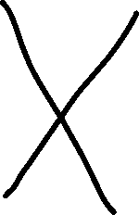

Alternative solution?
It’s @6!
Start simulating
It’s @6!
Fetch data, send to channel
.
It’s @6!
Fetch data from channel
Start simulating
tick! @6
tick! @12
1: tick price
2: tick price
…
…
10: tick price
[1] price
11: post2node
Unbuffered channel
[12] simulator
12: tick simulate
I am stuck here, where is [2]’s data?
[2] price
13: delayed transactor
Unreliable REST API

Slide 13





Alternative solution?
It’s @6!
Start simulating
It’s @6!
Fetch data, send to channel
.
It’s @6!
Let me count buffer, only 1 data, fetch it, then
Start simulating
tick! @6
tick! @12
1: tick price
2: tick price
…
…
10: tick price
[1] price
11: post2node
Use Buffered Channel instead?
[12] simulator
12: tick simulate
Recovered, and send you data, but it’s late!
It also results in two price tickers[2] existing in next round!
[2] price
13: delayed transactor
Unreliable REST API

Slide 14

Probe 2 –React Chart Probe 3 - result
setInterval (fetch data ) {
setState( newdata )
}
Render() {
<LineChart price = {newData} />
}
ChartGrid
GetNewProps (fetch data ) {
setState( props.price )
}
Render() {
<Line … / >
}
…
LineChart 1
LineChart 2
LineChart 9
See demo

Slide 15
Demo of this Architecture
Real-time task
( synch )
Non real-time task
( Asynch )
Browser UI
Restful get
BTC-USD
Go Bot
server
RESTful
goroutines
Express
RESTful post
simulating
persist

Slide 16
Remarks
…

Slide 17
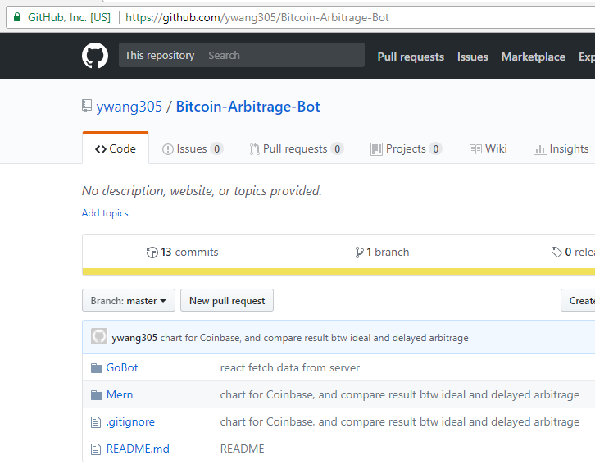
Question?
Github:
Fork it here: https://github.com/ywang305/Bitcoin-Arbitrage-Bot
-- End --

